Slide 1


KeepItClean
Notes:
Inspired by the organisation Håll Sverige Rent, we came up with the idéa for creating an application to make it easier for those already invested in cleaning up the city environment.

Slide 2
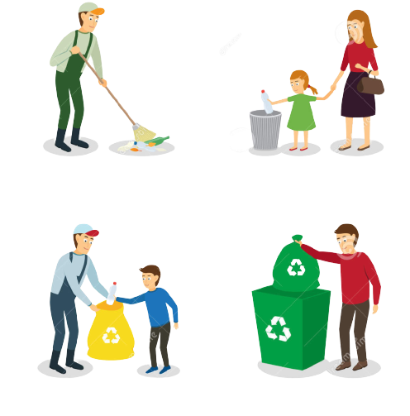
What have you made?
Notes:
Demonstration of the product

Slide 3

Notes:
Demonstration of the product

Slide 4
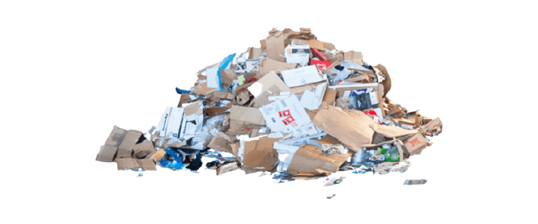
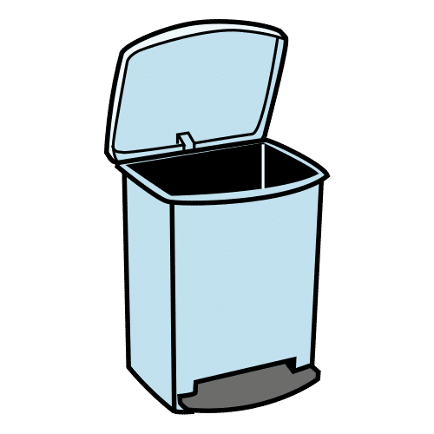
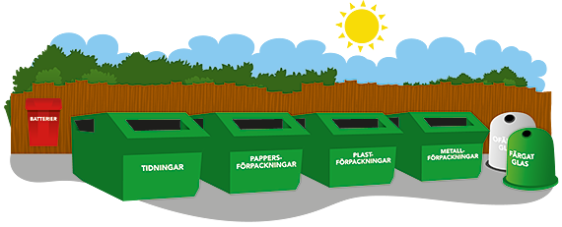
What challenge or problem does the system address?
Notes:
Solve the difficulties with finding nearby garbage bins and recycling stations
Make it possible for our users to share littered locations
Make it easier for our users to find littered locations to clean

Slide 5


Why you made the system
Notes:
Remove this slide?

Slide 6
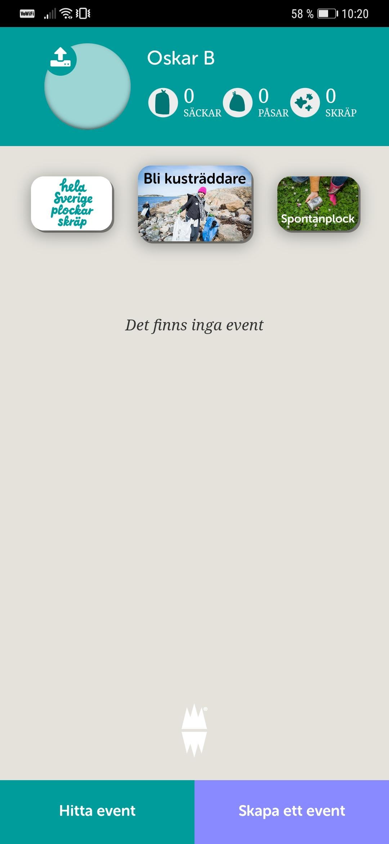
Research other apps
Skrappen
Made to create events
Unsuccessful
Notes:
Made by Håll Sverige Rent
Main functionality: Create cleaning events
Not very successful or used
We took away from this, what not do to and what had already been tried.

Slide 7
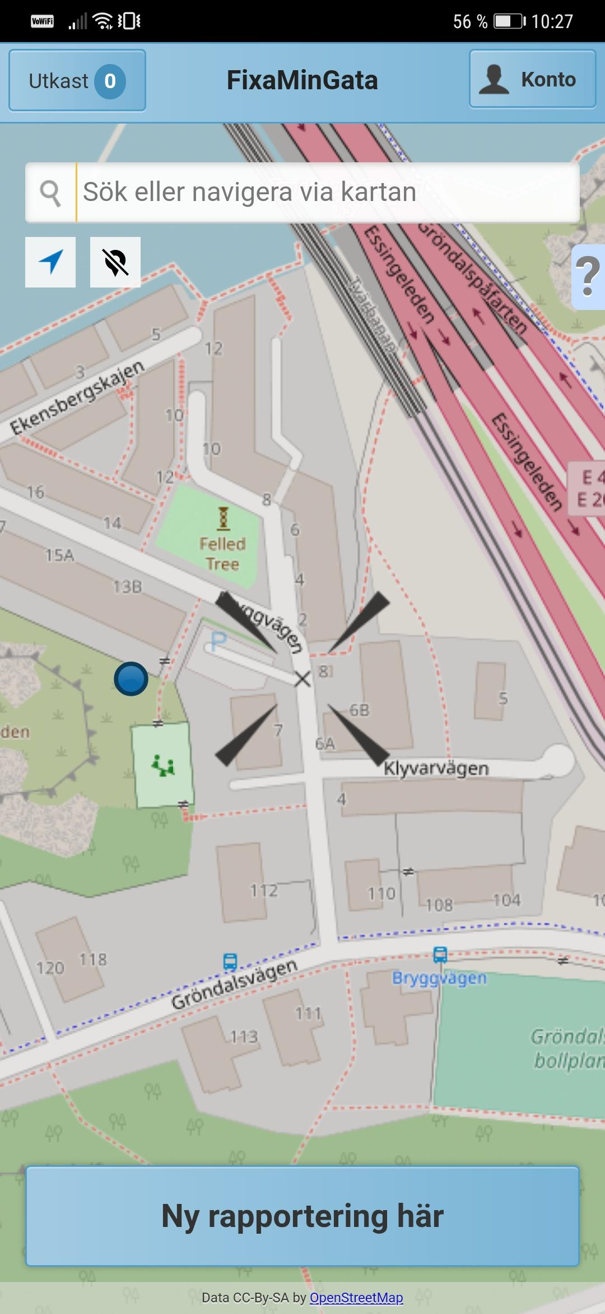
Research other apps
FixaMinGata
Made to report damages in the city environment
Unsuccessful
Notes:
FixaMinGata was created to make it possible for citizen to report damages to the local authority
Not very successful
However, it was easy to report but did not offer anything else for the user.

Slide 8
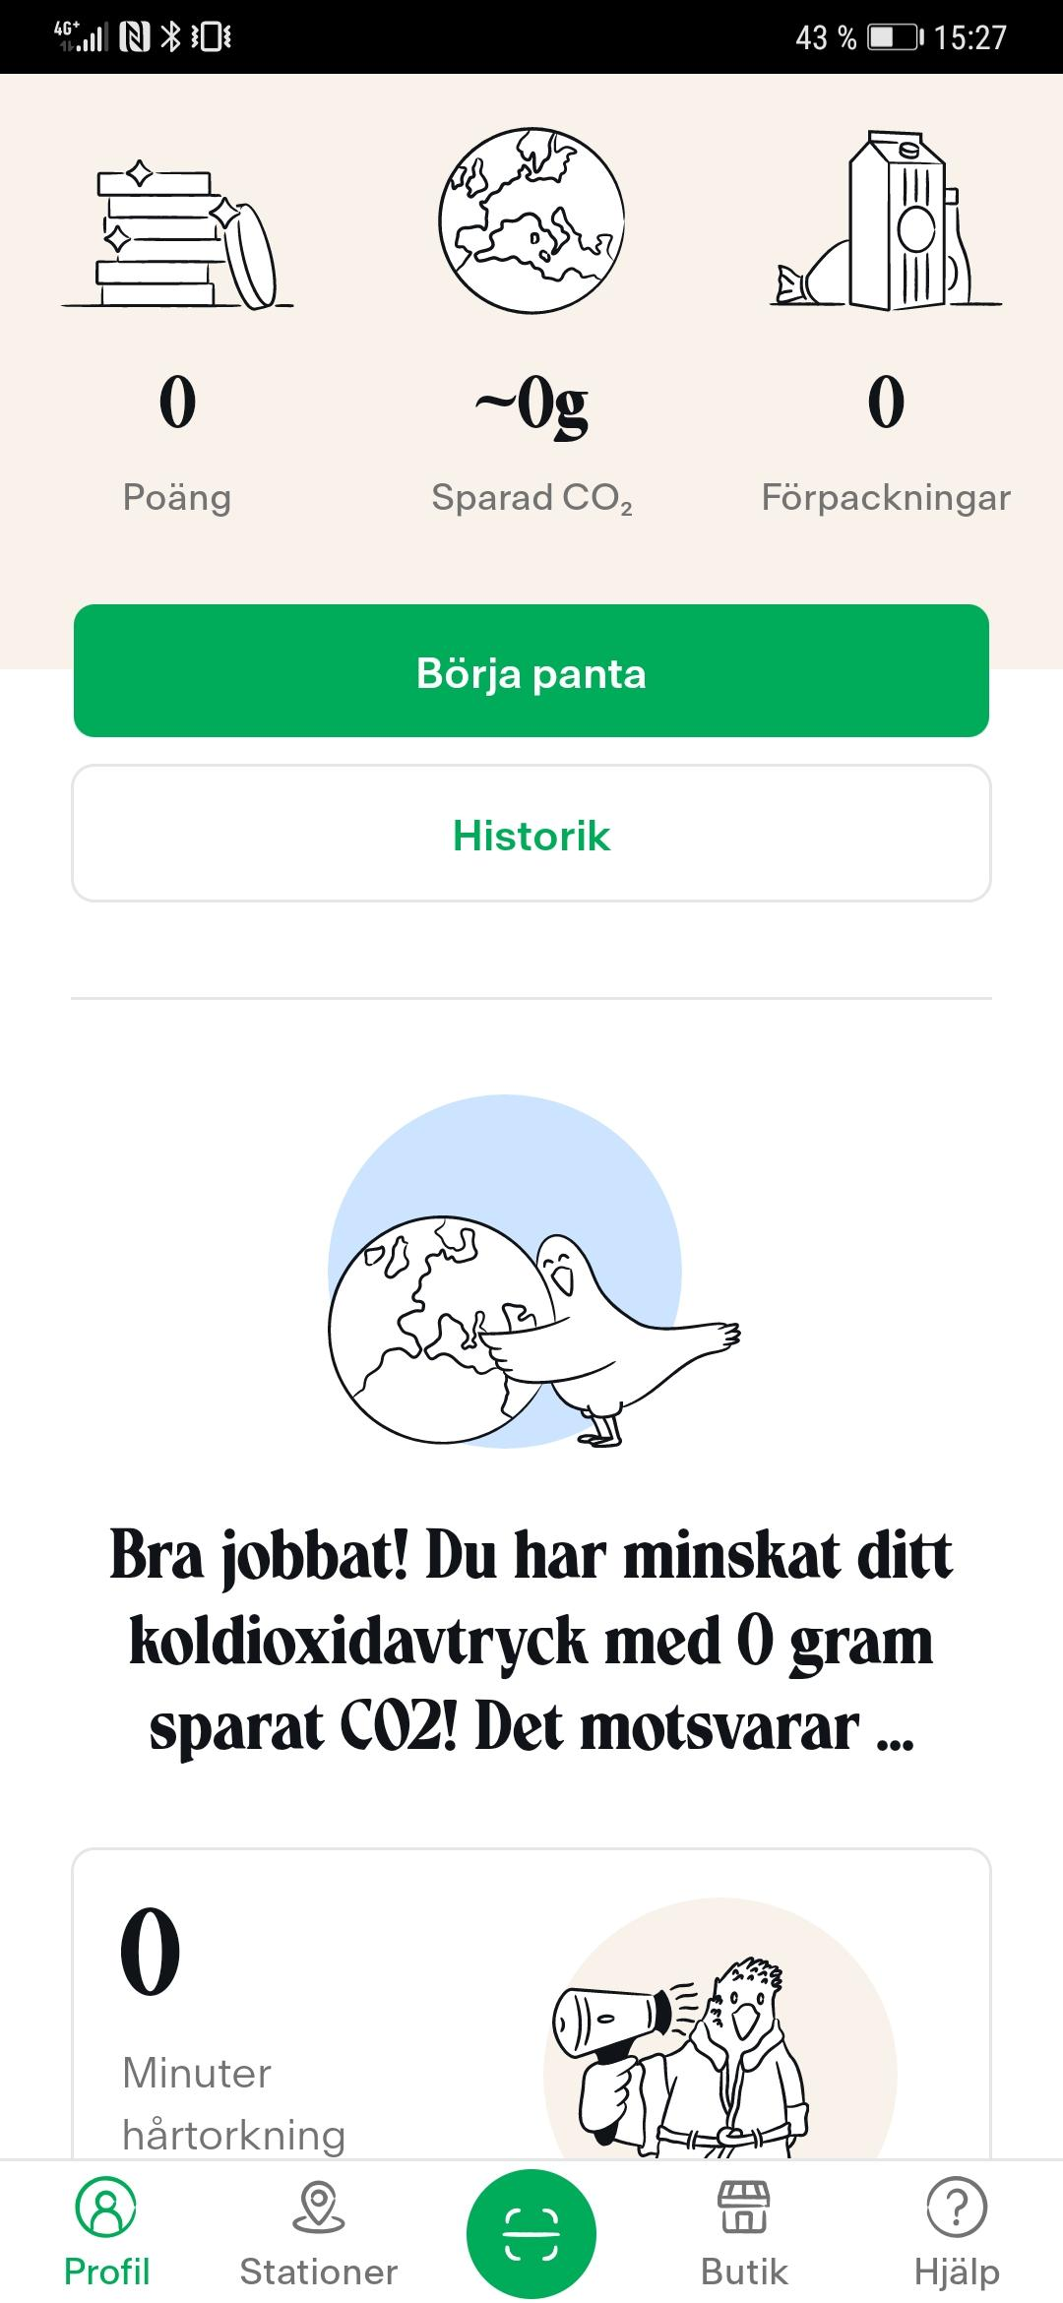
Research other apps
Bower
Made to motivate and reward recycling
Successful
Notes:
Bower was created to motivate and reward recycling
very successful, even though it requires some work from the user to scan the barcodes when recycling, the rewards gave the users enough to make the app popular.
However, we did not want to make it more complicated to use our app since giving rewards including money would be difficult
But it showed that a good reward system can do wonders.
But

Slide 9


User Research
Survey
Interviews
Notes:
Our first user research were an online survey, where we wanted to find out the main pain point. The survey went out to facebook groups who were inspired by håll sverige rent. 21 users did the survey
We found that: Main issue is finding garbage bins, a lot of the users clean by themselves while taking a walk or doing errands.
After going through the results of the survey, we performed interviews to get more detailed information to investigate further the main issues we wanted to fix.
This was done with 5 users

Slide 10
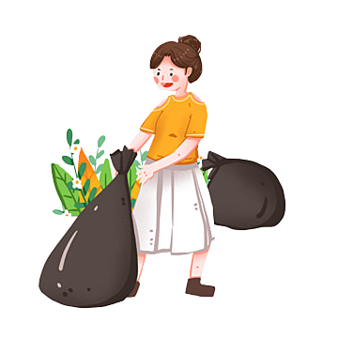
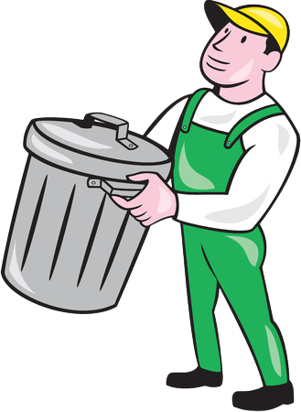
Who is it for?
Notes:
Already invested litter gatherer mainly, to make it easier to clean littered places when out and about.
Can also be useful for anyone walking around with garbage they want to throw away or trying to find recycling stations.

Slide 11
Gunilla Svensson Age: 65 Location: Stockholm
Occupation: Retired
Status: Living alone
Motivations
Wants to take care of nature and the animals living in it, the animals should not be affected by litter at all
Finds it more pleasant to be outside when it’s clean
Wants & Needs
For people to engage in garbage collecting - wants to see families, schools, young adults and elders collaborating.
Everyone should be able to enjoy a nice and clean outdoor environment
Pain Points
When reporting a littered location to the municipality, it takes too long for them to act
“It’s rude and a disaster for the environment that people throw garbage in our nature”
Notes:
We created a couple personas based on our research

Slide 12
Jonas Lundberg Age: 31 Location: Stockholm
Occupation: IT
Status: Girlfriend and 4 year old son
Motivations
Worries about the environment and don’t want garbage ending up in the water
Tries to inspire others by making himself visible when collecting garbage
Wants & Needs
For people to collaborate collecting garbage and for everyone to contribute to a cleaner environment
Pain Points
Annoying not having the right equipment with me. If I were to pick up sticky objects with my hands, where would I wash them?
“I think everyone should do their part to contribute to environmental sustainability”
Notes:
Hoppa över

Slide 13

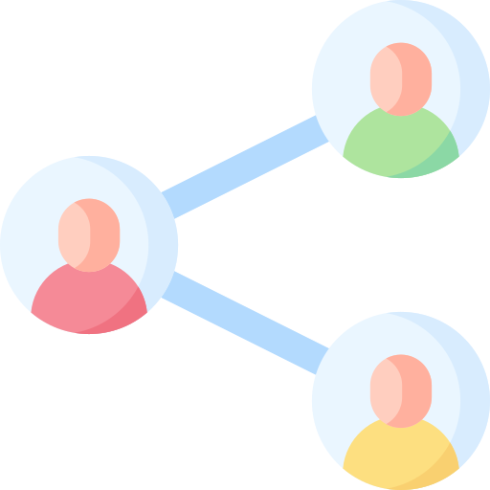
Biggest Challenge
How users share littered locations
How to make the application usable on the go
Notes:
When designing, the biggest challenge was to find the best way for users to share littered locations
as well as making the application easy to use on the go.

Slide 14


User Testing
Notes:
For the user testing, we made a prototype using adobe XD
In the beginning everyone made their own design, resulting in many different design choices, and then we looked at them together to create a prototype with the ideas we liked the most.

Slide 15






User Testing - Round 1
Made share button gray until everything is filled in
Location fills in automatically on your location
Filter buttons with border when active
Added icon when littered location is being cleaned →
Added icon when littered location is done →
Changed Event-icon →
Changed littered location icon →
Notes:
Explain every point and why it was changed
We also confirmed that the app was easy to use which led us to stay with the main design of the app.

Slide 16
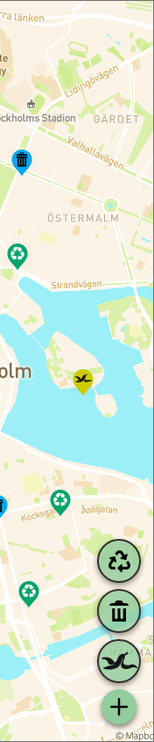
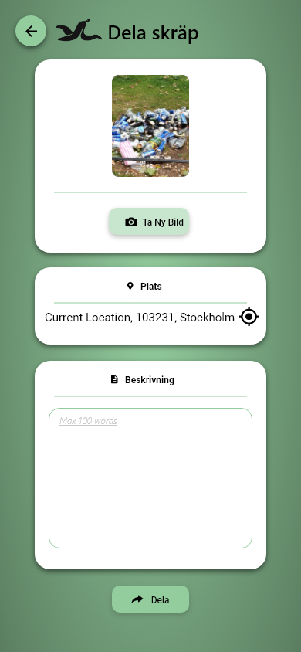

User Testing - Round 2
The filter-icons were moved down for easier usage
Added the garbage-icon on the create page
Littered location filter icon was moved
→
Notes:
Due to this being used on the phone, during the user testing we noticed difficulties with reaching on the upper right so we moved it down so it would be easy to reach with your thumb.
Some users were a bit confused about where the littered location end up after creating it. We added the icon on the pin on the create page to make it easier for new users.
Although the users had no trouble finding the garbage bin filter function, some mentioned it could be associated with a delete function. We did not want to change the icon itself since it did seem to do its job, but instead changed its position to not up on top which could add to that mindset.

Slide 17
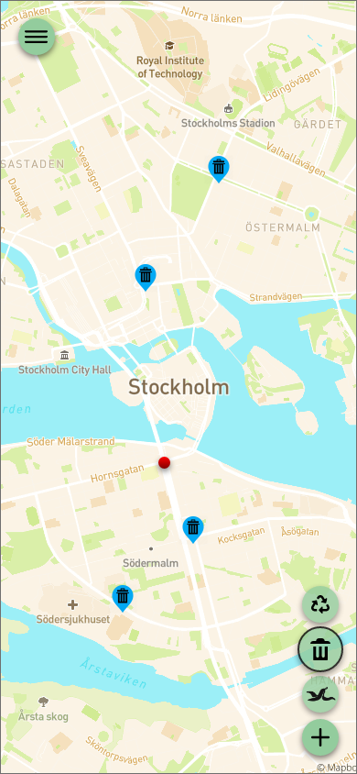
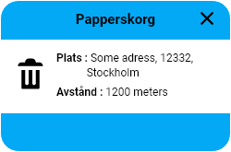
Core Feature
See Nearby garbage bins
Notes:
The main issue most of our users had were finding nearby garbage bins

Slide 18
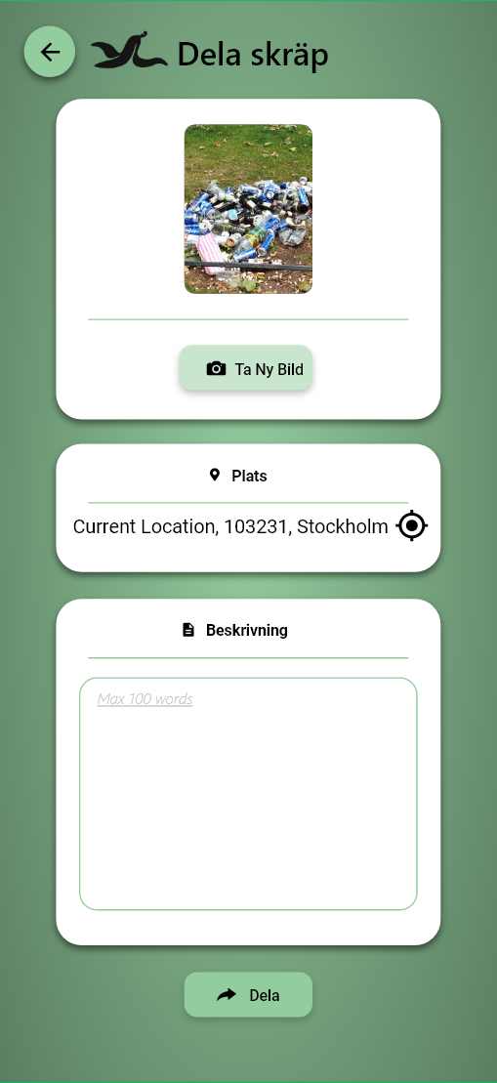
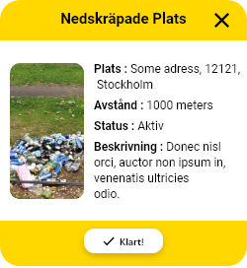
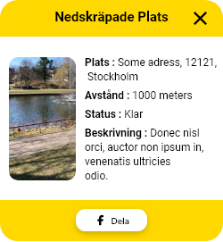
Core Feature
Share Littered Locations
Notes:
The main functionality and interaction users will have with our app is reporting littered areas and cleaning them up to display on our platform.
Since most of the users clean when out and about, it will be easy to see if there is any place needed cleaning on your route
Sometimes you do not have the required tools, do not have the time or think that it may be “too nasty” to clean yourself
In these cases you report it for other users to see and can bring the right tools, have different tolerance levels or have time on their walk.

Slide 19
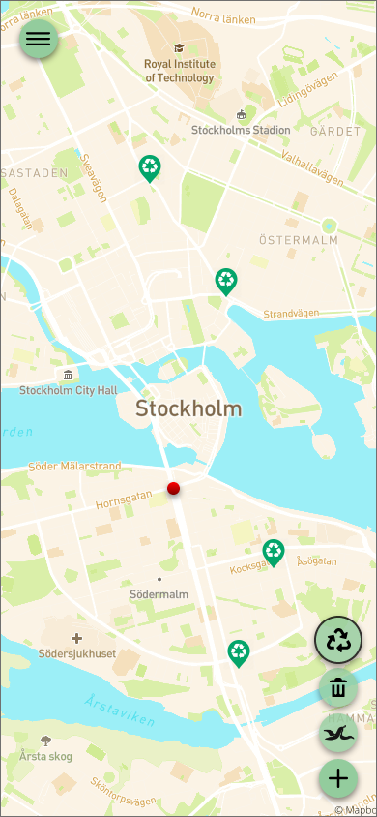
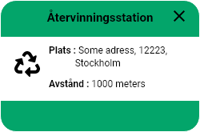
Core Feature
See Nearby recycling stations
Notes:
Although most users throw in the closest garbage bin, if they know a recycling station is nearby they would rather recycle
We want to help them with this behaviour, and thereby seeing nearby recycling stations is an important feature.

Slide 20
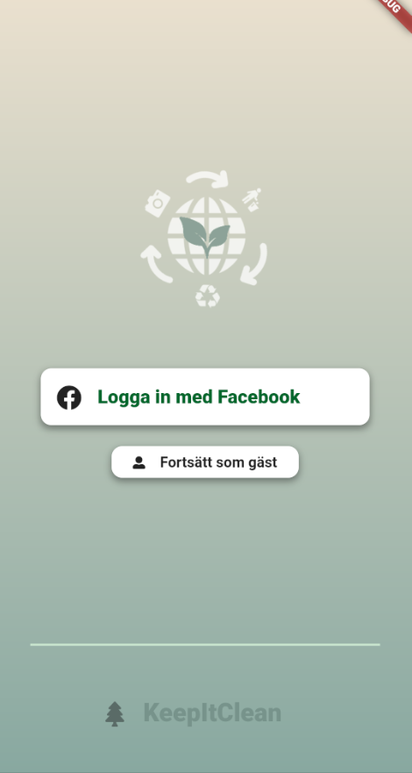
Additional Features
Log in with facebook
Continue as a guest
Notes:
Guest login will not allow the user to save statistics

Slide 21
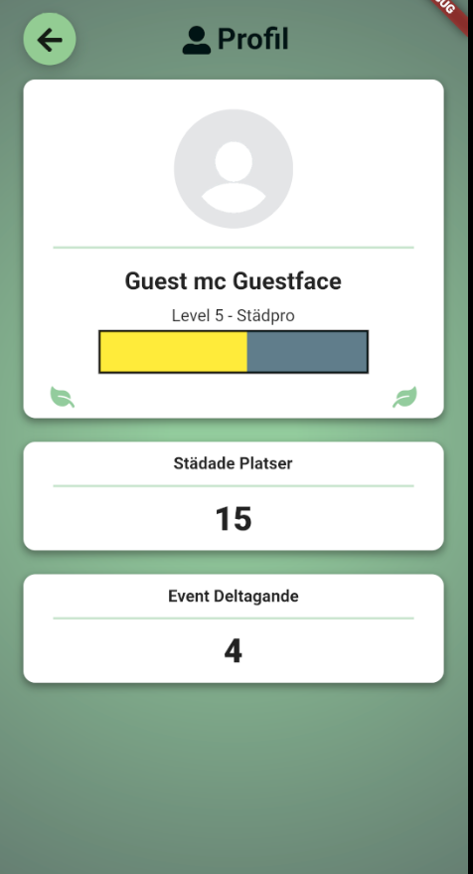
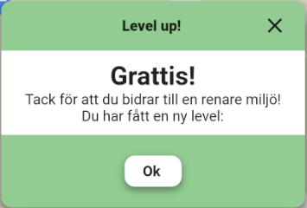
Additional Features
Have a profile
See and save statistics
Level up and get titles

Slide 22
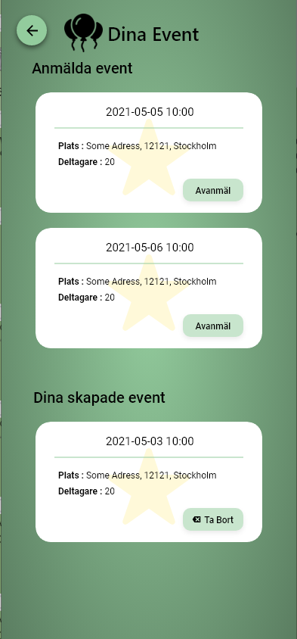
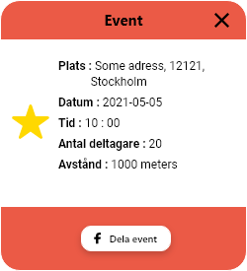
Features Dropped
Events
Notes:
There is already a successful application, called Facebook, creating cleaning event such as this.
Our focus is more on the individual cleaning, and given that Skrappen had a main focus on events failed we can be certain that this is not a good way to go.
New users might think that the application is dead since there are no events.

Slide 23




API and Data Sources
Garbage Bins (Data portalen)
Recycling Stations (Data portalen)
Facebook API
Google Maps API
Cloudinary
Notes:
Cloudinary
To handle our pictures

Slide 24

What would the future of the project be?
Develop and research further how the reward system can be improved
Notes:
Develop the reward system/levels
Develop the event function
Make the application more social (see location of other users on the map etc.)

Slide 25

What would the future of the project be?
Reporting in to the local authority
Notes:
Nothing that was planned
But a couple people showed interest

